Slide 1
Data Structures Workshop
Day 27

Slide 2
Workshop Outline
Depth-First Search Implementation
Breadth-First Search
Minimum Spanning Trees
Prim’s and Kruskal’s Algorithm
Dijkstra’s Algorithm

Slide 3
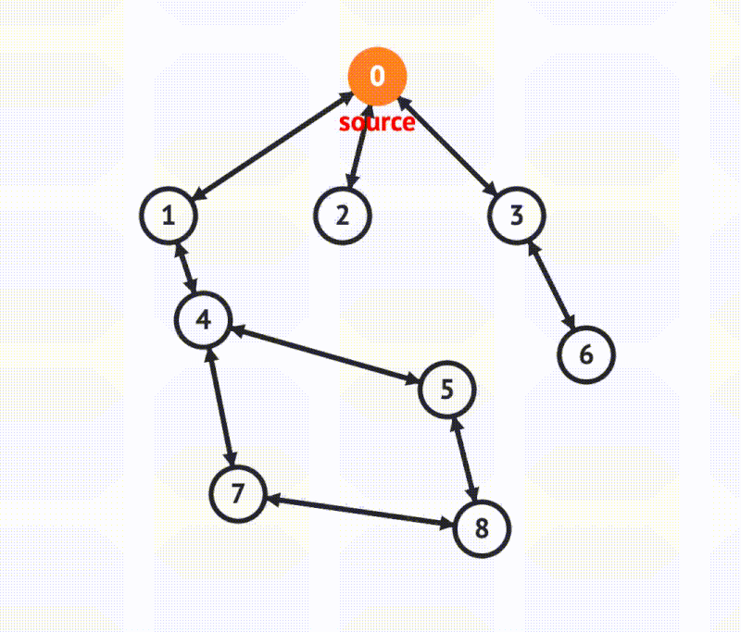
DFS Algorithm
A graph traversal that visits a starting vertex, then visits every vertex along each path starting from that vertex to the path’s end before backtracking.
What we want to do is mark each vertex as we visit them and try to avoid cycles (so if already visited or being visited, we don’t need to traverse to it again).

Slide 4
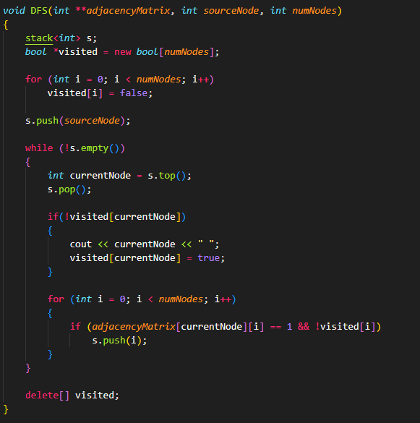
DFS Implementation [Adjacency Matrix]

Slide 5
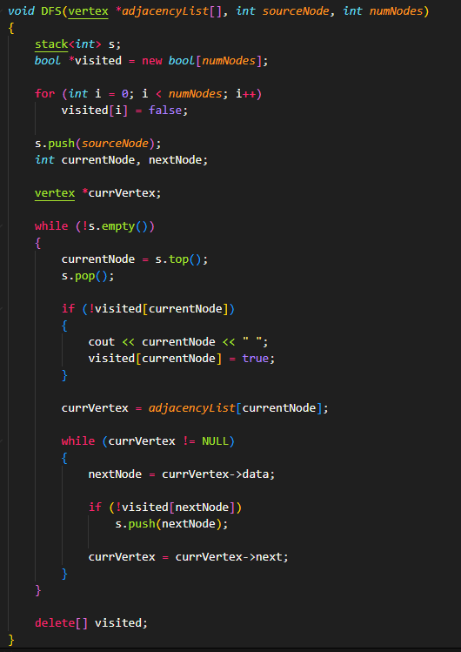
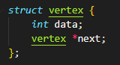
DFS Implementation [Adjacency List]

Slide 6
Breadth-First Search

Slide 7

Breadth-First Search Algorithm
A graph traversal that visits a starting vertex, then all vertices of “distance” 1 from that vertex, then distance 2 and so on. In other words, it explores all the nodes at the current depth before moving on to nodes at the next depth level.

Slide 8
BFS Explained
The BFS algorithm uses a QUEUE in the following manner:
1. Start by putting any source vertex in the queue
2. Take front item of queue and add to visited list
3. Create list of that vertices adjacent node. Add the ones which aren’t in the visited list to the back of the queue.
4. Repeat steps 2 and 3 until queue is empty.

Slide 9
DFS vs. BFS
Here you’ll notice that the DFS and BFS algorithms work in the same exact way, the only difference is one uses a stack, and the other uses a queue.

Slide 10
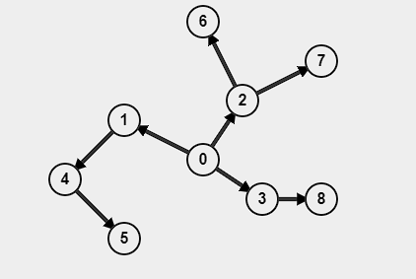
BFS Tracing Example
Given the following graph, perform the BFS algorithm and output the order in which the nodes are visited. Assume the source node is ‘0’.
Solution:
0, 1, 2, 3, 4, 6, 7, 8, 5

Slide 11
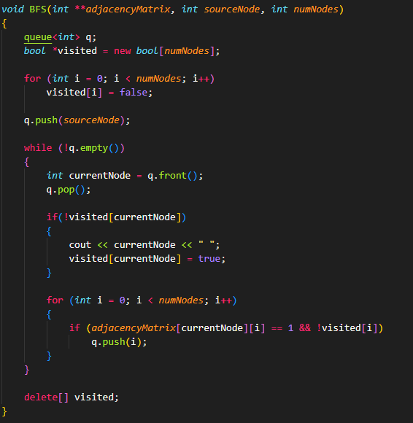
BFS Implementation [Adjacency Matrix]

Slide 12
Minimum Spanning Trees (MSTs)

Slide 13
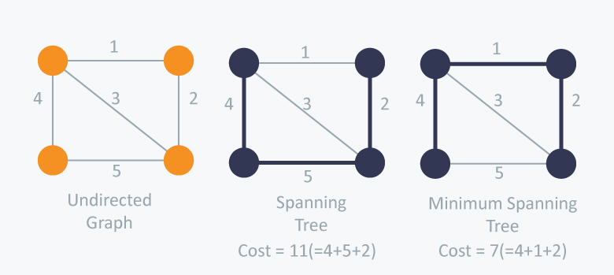
Minimum Spanning Trees
A subset of the edges of the graph that connects all the vertices together without forming any cycles and has the minimum possible total edge weight.

Slide 14
Prim’s Algorithm
An algorithm used to find the Minimum Spanning Tree of a given graph.
Prim’s algorithm starts from a specific, given vertex and then it chooses the next vertex with the smallest weight/cost that doesn’t create a cycle. It will continue this process until all vertices have been visited.
We start from one vertex and keep adding edges with the lowest weight until we reach our goal.

Slide 15
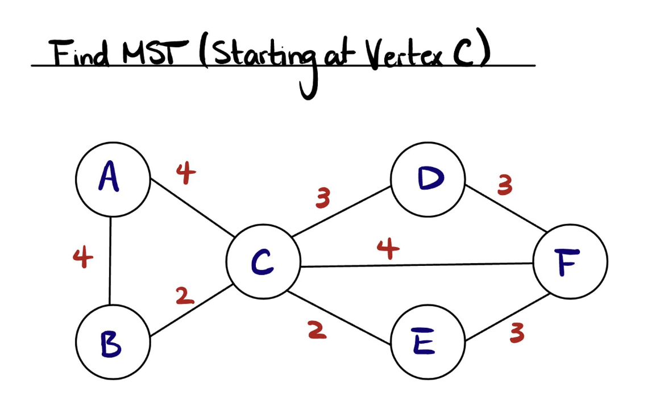
Prim’s Example

Slide 16
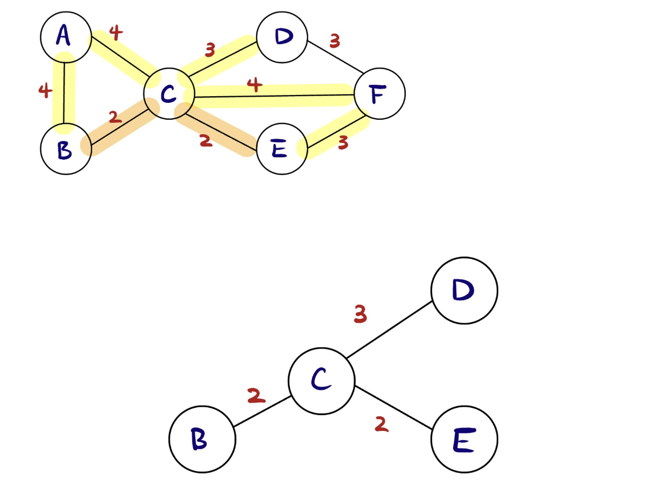
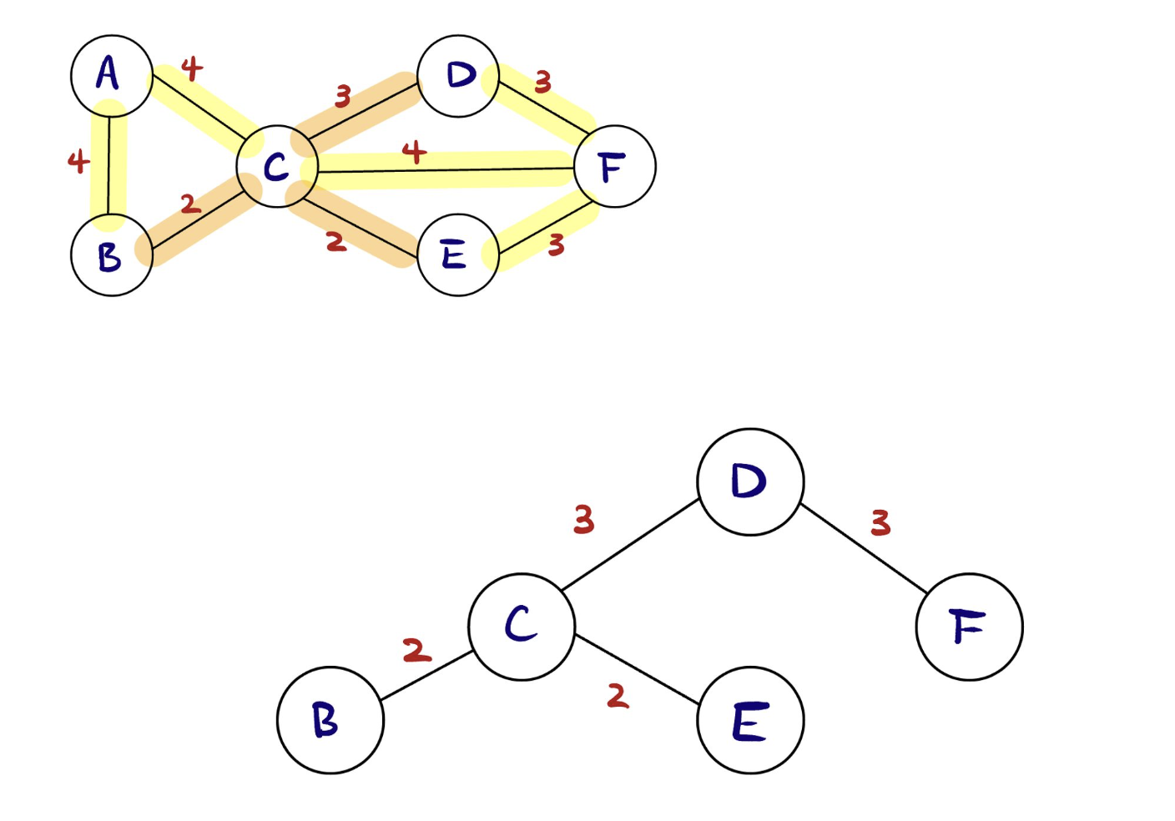
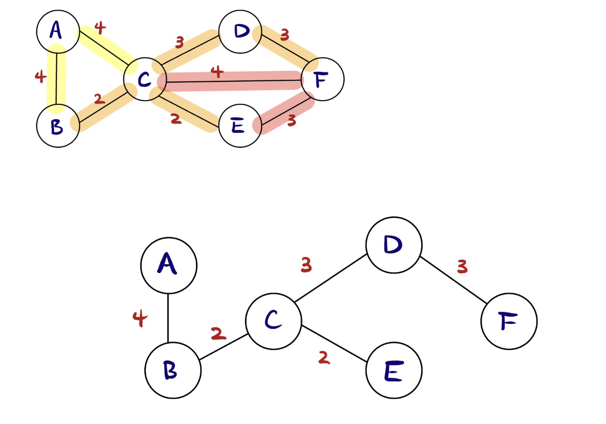
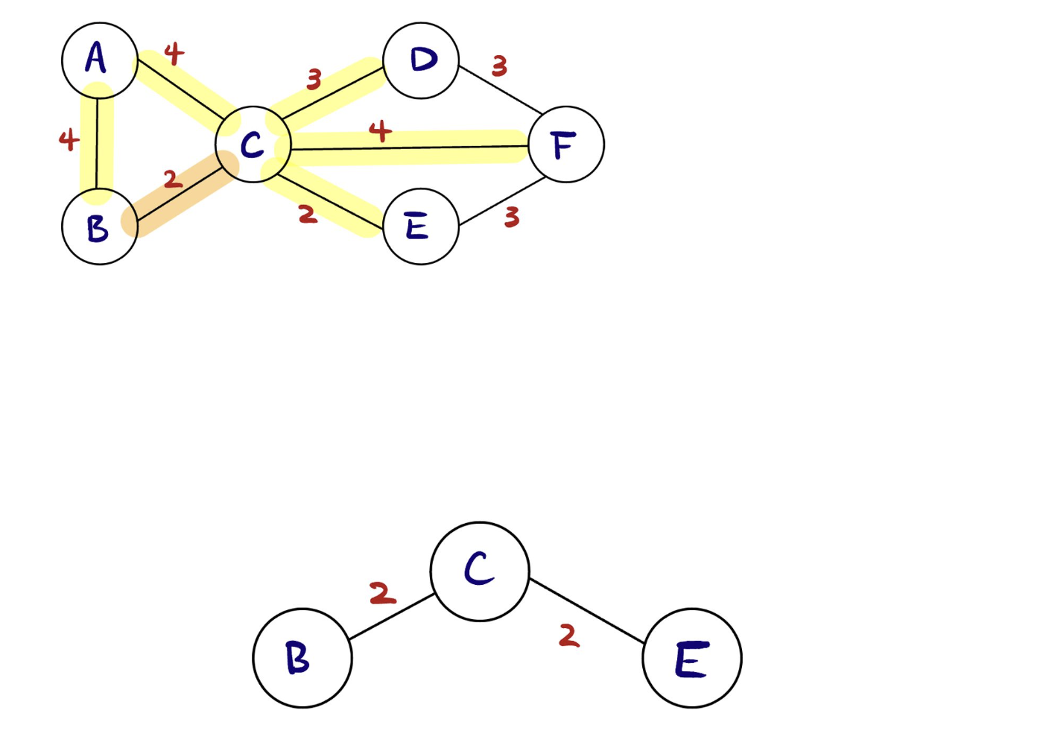
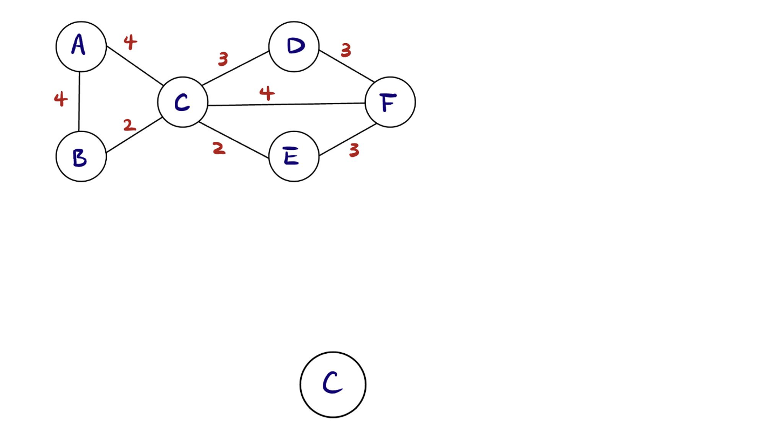
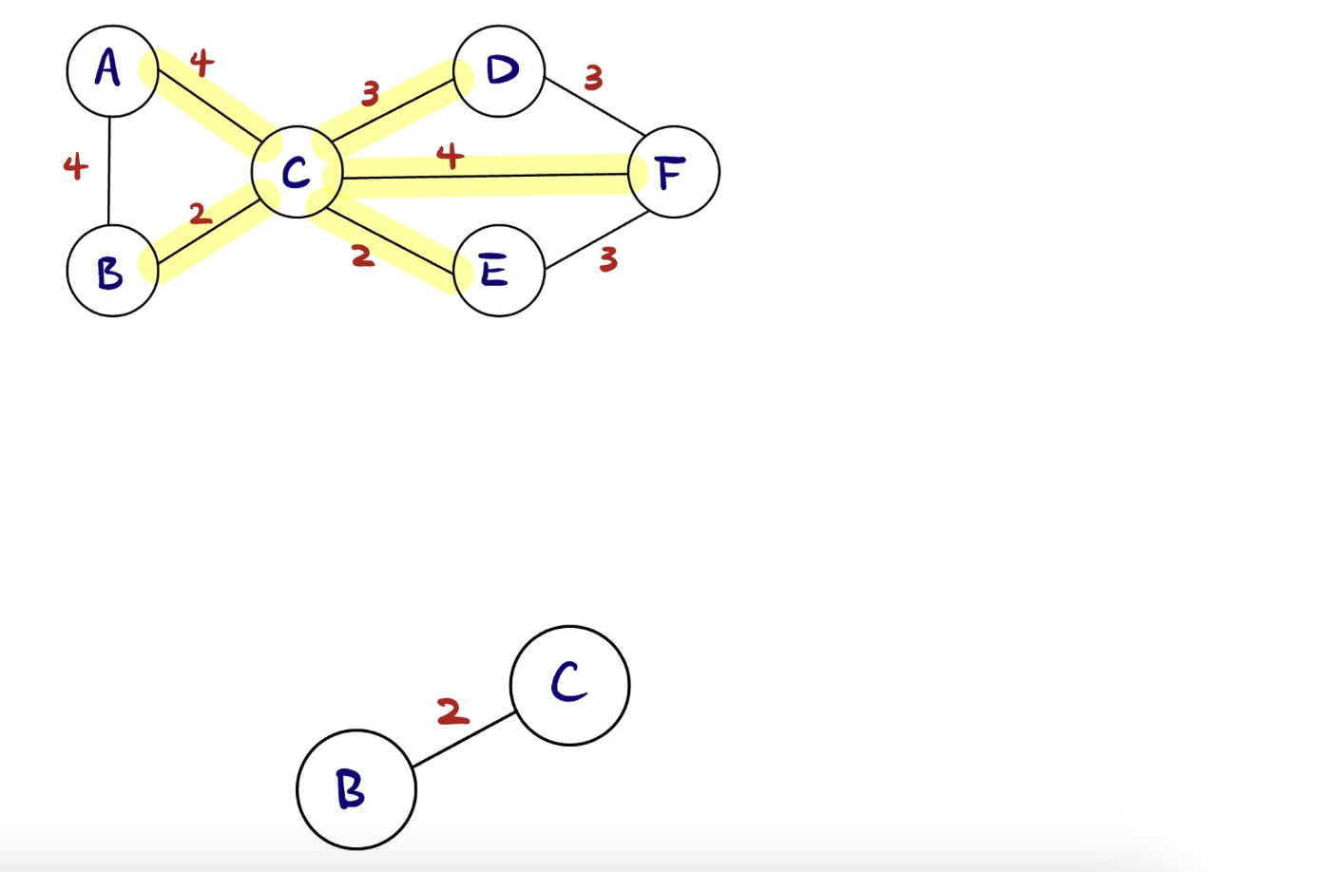

Slide 17
Kruskal’s Algorithm
Like Prim’s algorithm, Kruskal’s algorithm finds the MST of a graph.
Kruskal’s algorithm first lists all the edges from least to greatest in terms of their respective weights. It then chooses the edge with the smallest weight that doesn’t form a cycle. It repeats this process until all vertices have been visited.

Slide 18
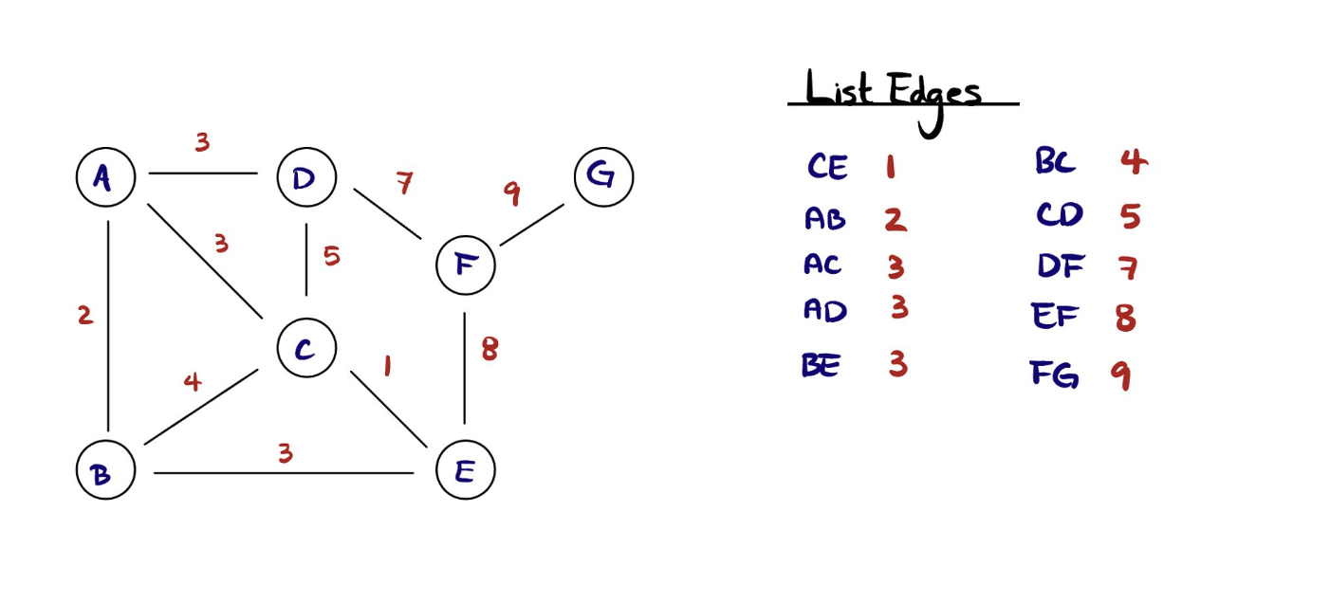
Kruskal’s Example

Slide 19
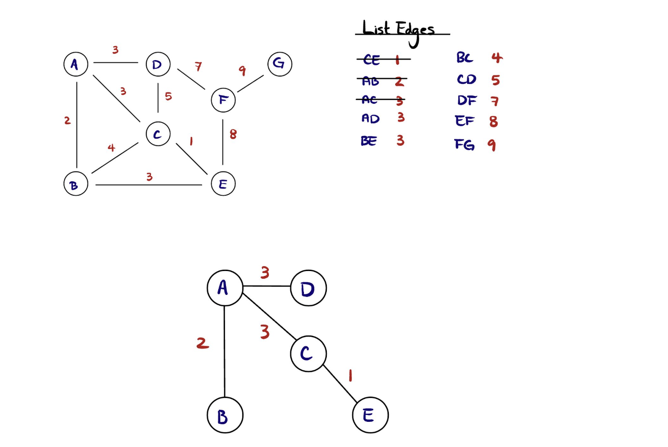
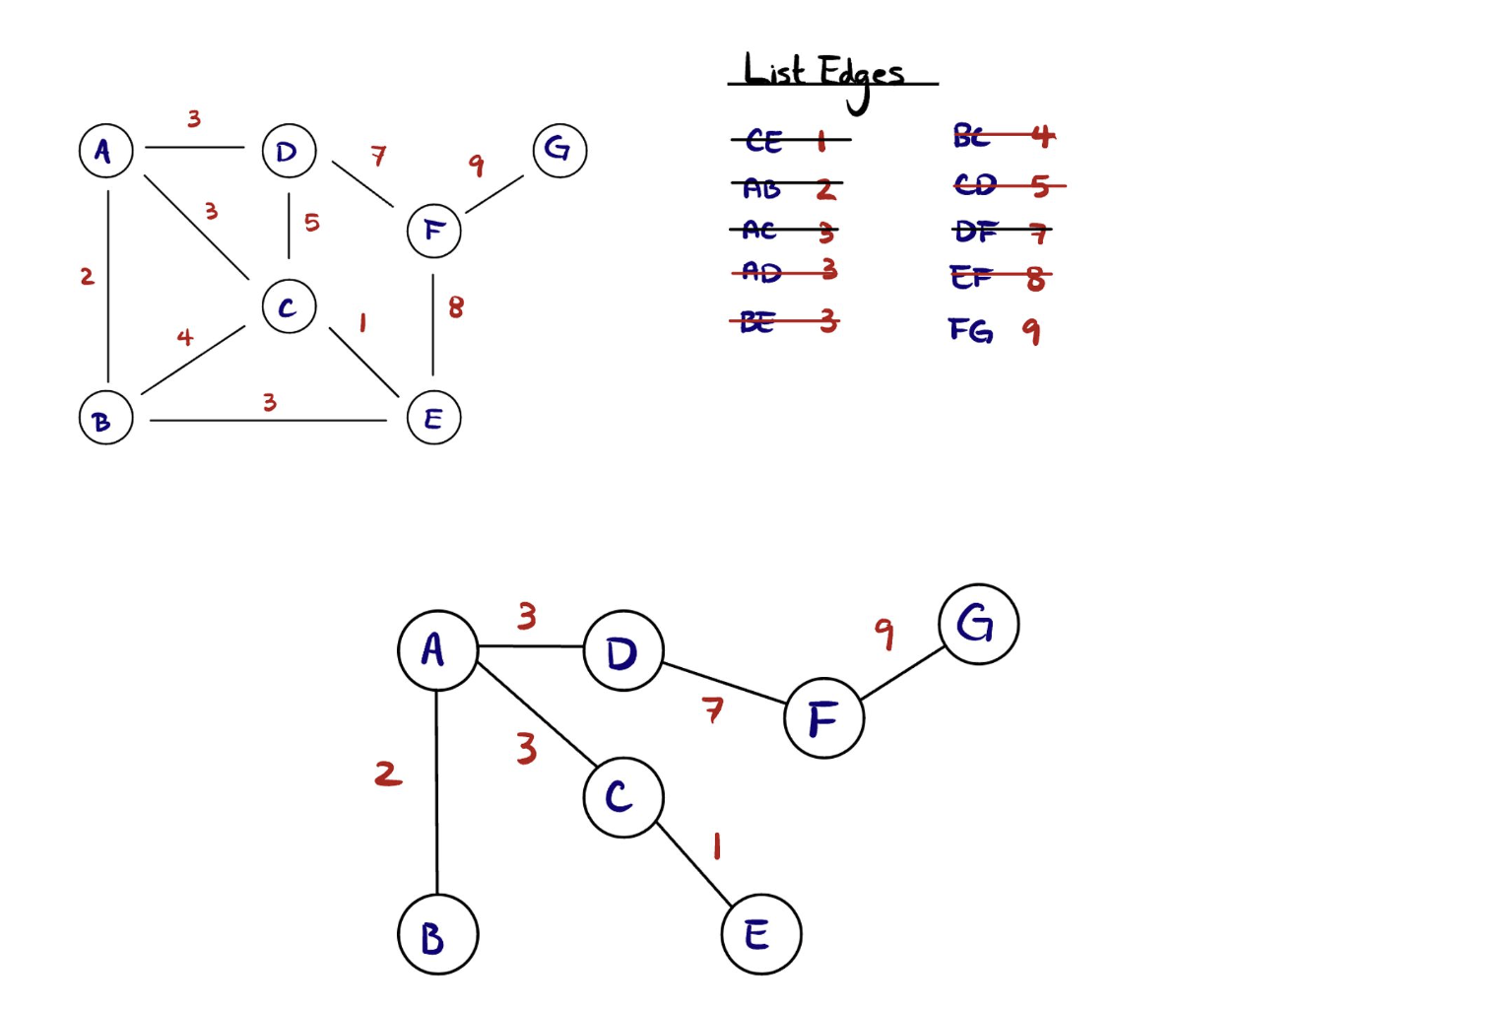
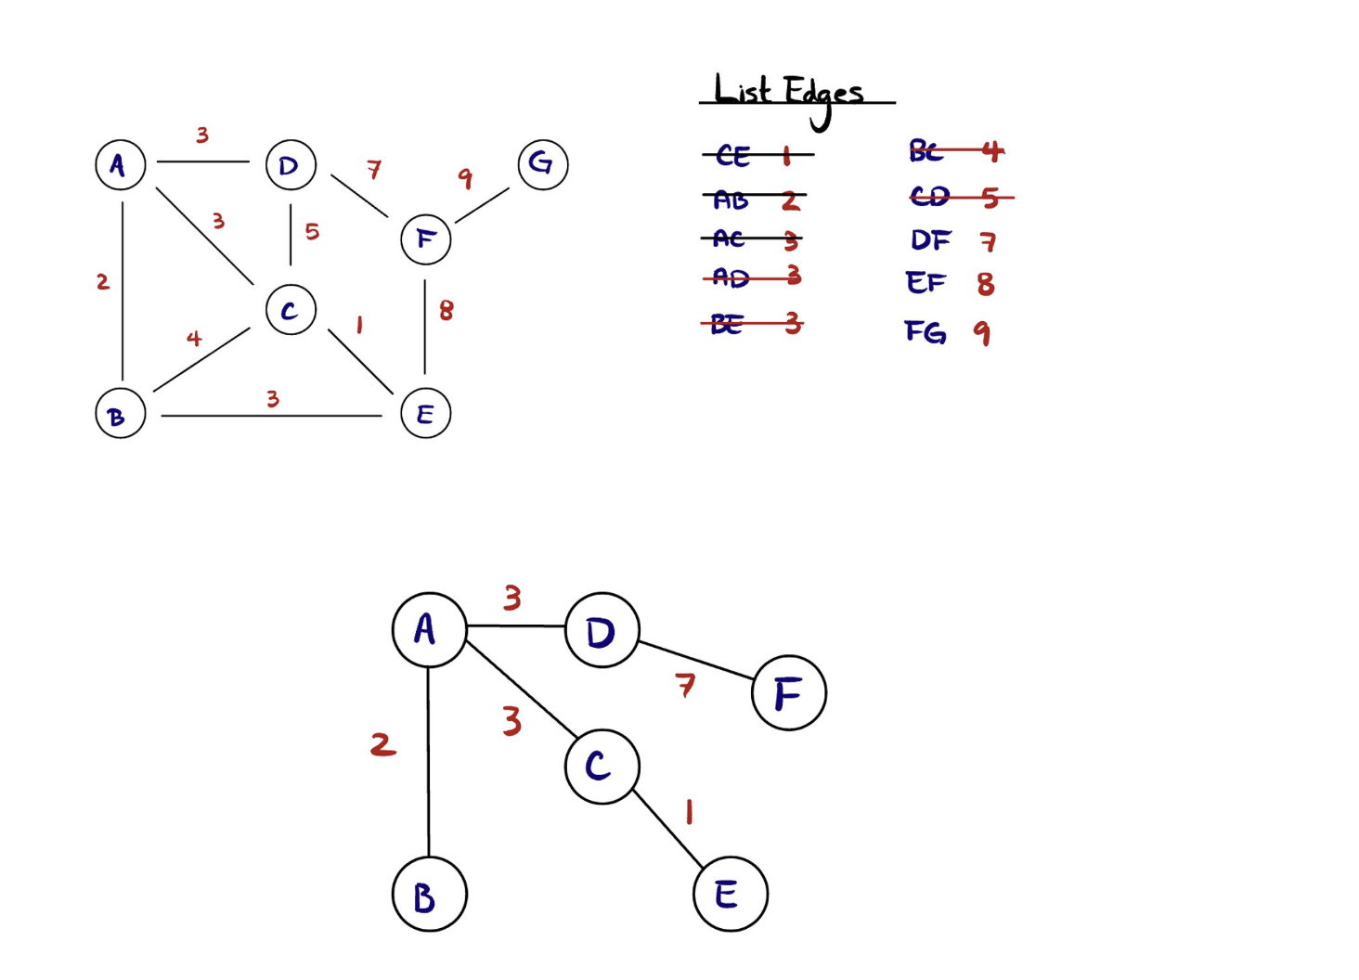
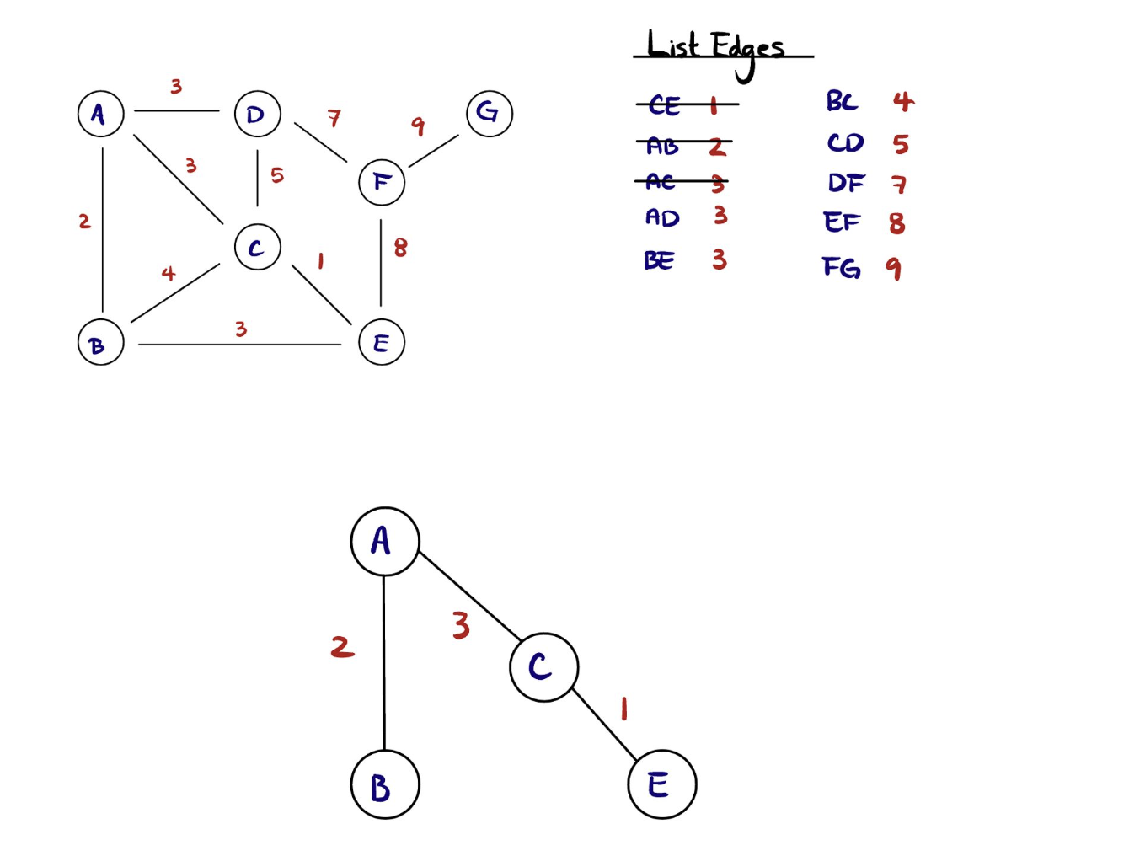
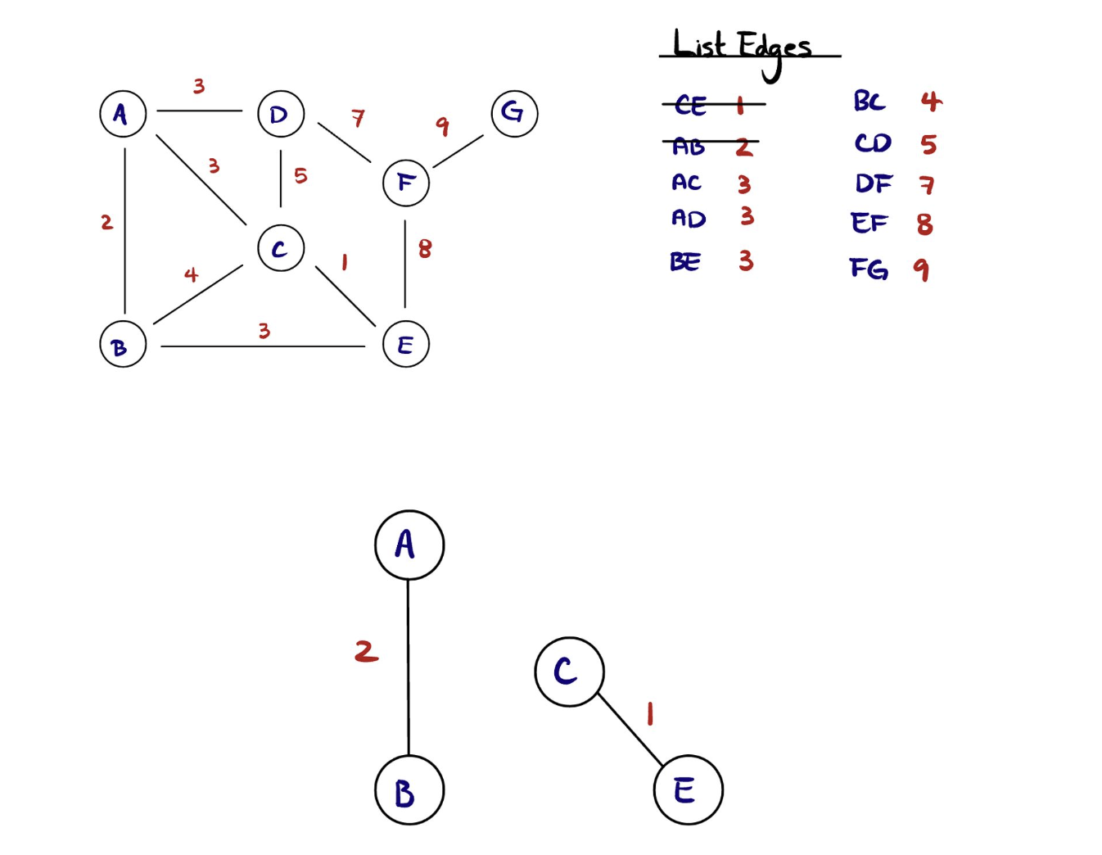
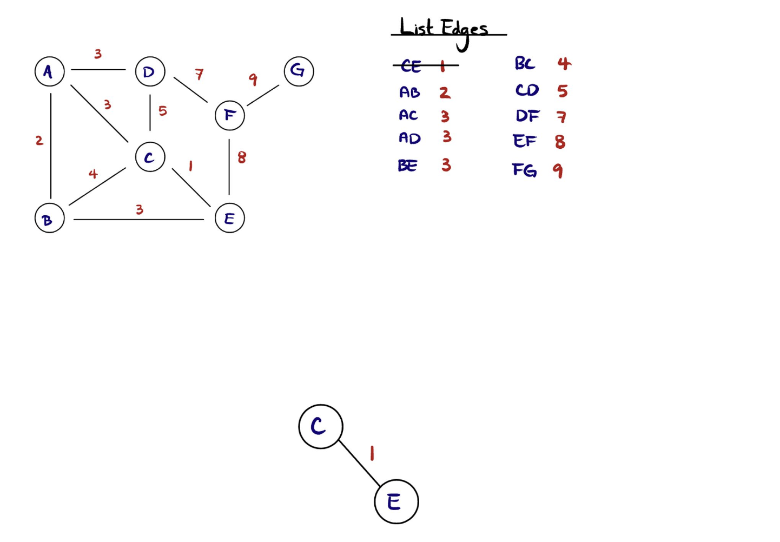

Slide 20
Dijkstra’s Algorithm
Also known as a “Shortest Path” algorithm, Dijkstra’s algorithm allows us to find the shortest path between a given vertex and all other nodes.
As well can be used to find shortest path from one vertex to another

Slide 21
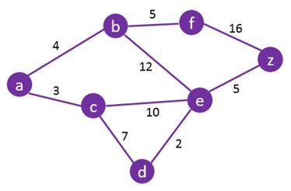
Practice
Find the SPT starting from node “a”. Show all work.
Current Vertex​​ | a | b | c | d | e | f | z
Visit the unvisited vertex with the smallest know distance from the source vertex

Slide 22
Solution
Current Vertex​​ | a | b | c | d | e | f | z
 | 0 | INF | INF | INF | INF | INF | INF
a |  | 4 | 3 | INF | INF | INF | INF
c |  |  |  | 10 | 13 | INF | INF
b |  |  |  |  |  | 9 | INF
f |  |  |  |  |  |  | 25
d |  |  |  |  | 12
e |  |  |  |  |  |  | 17
z

Slide 23
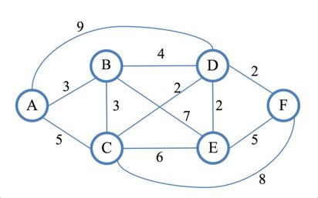
More Practice
Find the SPT starting from node “f”. Show all work.
Current Vertex​​ | a | b | c | d | e | f
 | INF | INF | INF | INF | INF | 0

Slide 24
Solution
Current Vertex​​ | a | b | c | d | e | f
 | INF | INF | INF | INF | INF | 0
f | INF | INF | 8 | 2 | 5
d | 11 | 6 | 4 |  | 4
e
c | 9
b
a
Current Vertex​​ | a | b | c | d | e | f
 | INF | INF | INF | INF | INF | 0
 | INF | INF | 8 | 2 | 5
 | 9 | 6 | 4 |  | 4

